Slide 2
The FireIce Shield® Product Line
Additional formats are available for customized solutions

Slide 3
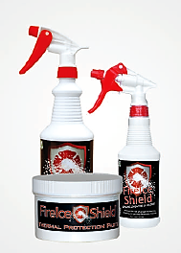
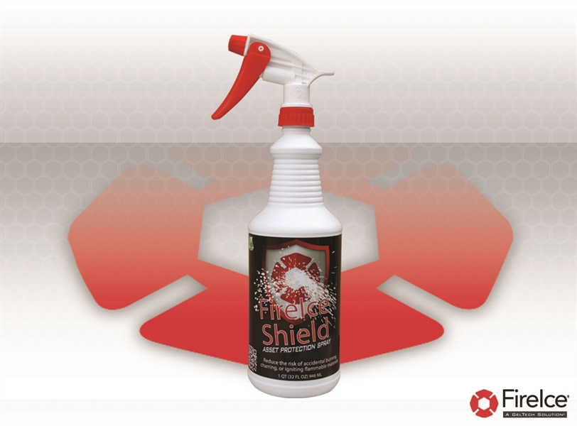
FireIce Shield® Spray and Paste
32 ounce Spray Bottle
16 ounce Spray Bottle
24 ounce Jar of Paste
Pretreat surrounding surfaces to protect them from heat transfer and to keep them cool. This is great for use on metal pipes as a barrier to heat transfer, especially for valves, seals, and between contact points. It will effectively prevent discoloration and distortion of lightweight metals, protect closely soldered parts and protects surfaces like wood, sheetrock, wires, insulation, and painted or finished surfaces including painted metal, plastic, cloth, and vinyl from direct and radiant heat.

Slide 4
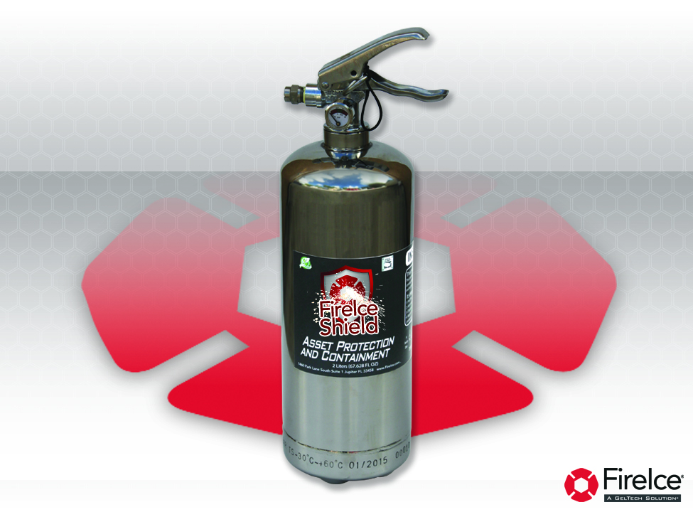
FireIce Shield® 2 Liter: Asset Protection and Containment
64 Ounce FireIce Shield® Canister
for Asset Protection and Containment
64 ounce Liquid Refill
For use in larger areas; best defense for surfaces affected by heat-related damage and for blocking heat transfer; protects adjacent surfaces while soldering, welding, and brazing, reduces the risk of accidental charring, burning, or igniting flammable materials in excess of 5,000 degrees. Perfect for use wherever workers are doing “hot work”; available precisely measured liquid refills allow for simple refilling of spent canisters—just pressurize in accordance with manufacturer’s instructions
Notes:
The second format is the 2 Liter canister. Here you see the 2 Liter Canister for asset protection and containment. This is for use in larger areas and is the best defense for surfaces affected by heat-related damage and for blocking heat transfer. It also protects adjacent surfaces while soldering, welding, and brazing, reduces the risk of accidental charring, burning, or igniting flammable materials up to 10,000 degrees. It’s perfect for use wherever workers are doing “hot work”.
Precisely measured liquid refills are available. Simply refill the spent canister and pressurize in accordance with the manufacturer’s instructions

Slide 5
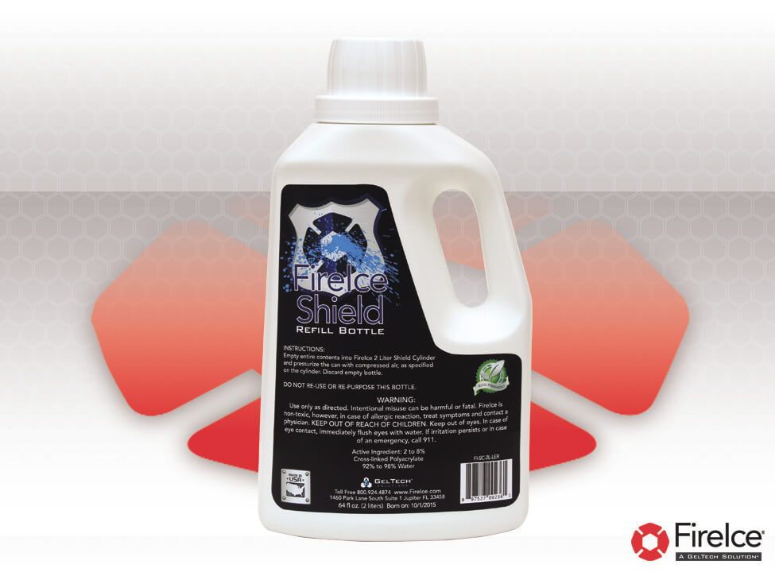
FireIce Shield® 2 Liter: First Responders
FireIce® Shield™ 64 ounce Canister:
First Responders
64 ounce Liquid Refill
Blended to be safe for use on people; intended for asset protection and containment; protects in even high temperature situations in excess of 5,000 degrees; versatility and purity make it perfect for first responders; ideal size for cruiser, command car or engine cab.

Slide 6
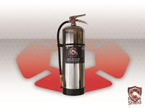
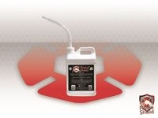
FireIce Shield® 2.5 Gallon Canister
FireIce Shield® 2.5 Gallon Canister
FireIce Shield® 2.5 Gallon Liquid Refill

Slide 7
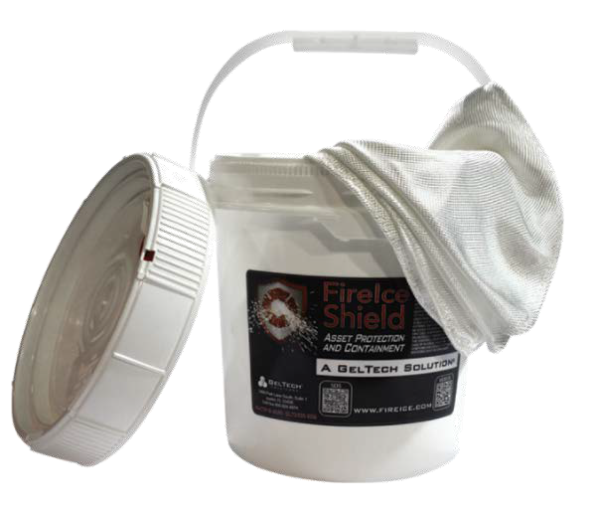
FireIce Shield® Blanket
FireIce Shield® Welding Blanket
Pre-hydrated, reusable and available in many sizes; indispensable for use in a wide variety of situations; drape over multiple objects to protect them from errant sparks or slag, wrap around wireways, place on the floor to protect finished floor surfaces, throw over a burning trash bin or used to cover a person in an advancing structure or vehicle fire.

Slide 8
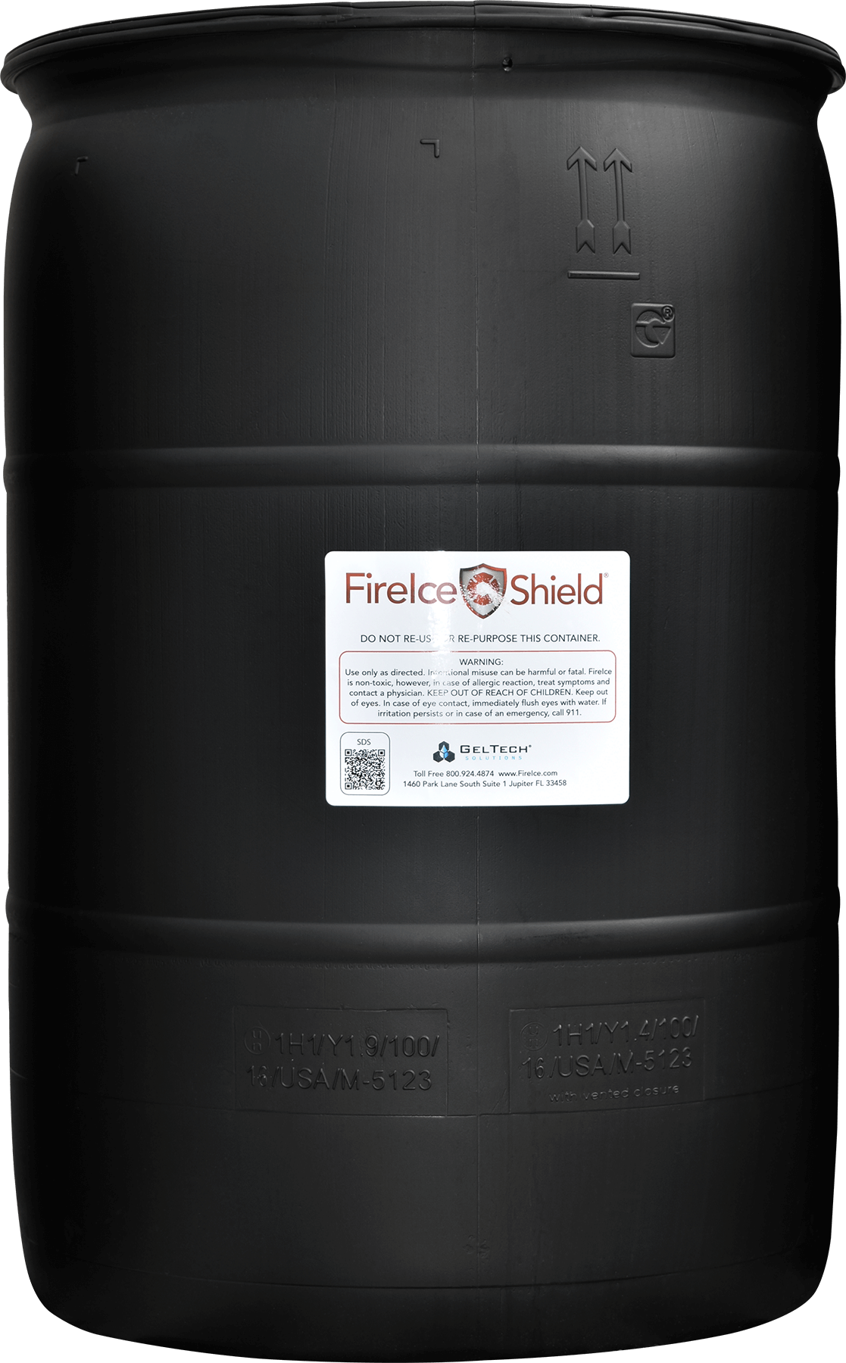
FireIce Shield® 55 Gallon Drum
FireIce Shield® 55 Gallon Drum is the most convenient way to refill 64 ounce and 2.5 Gallon Canisters or to top off FireIce Shield® Blanket containers after use. Because many large facilities already have “filling stations”, the drum is sold as is. Horizontal rests, spigots, regulators and other accessories are widely available for direct purchase.

